Slide 1

Introduction to Quantum Computing
Speaker: Nilay Shrivastava
Github: euler16
Twitter: @NilayShri

Slide 2
Structure and Aim of the Talk.
inspiration
approach
basics
Super-dense coding

Slide 3
Inspiration behind Quantum computing
‘Physics based programming’.
Nature itself computes solutions to problems that are seemingly impossible (read NP hard) for classical machine.
- Example: Soap Bubble Computer (Steiner Tree Problem).
- DNA programming, protein programming
- Issue:- nature doesn’t always settles for global optima.

Slide 4
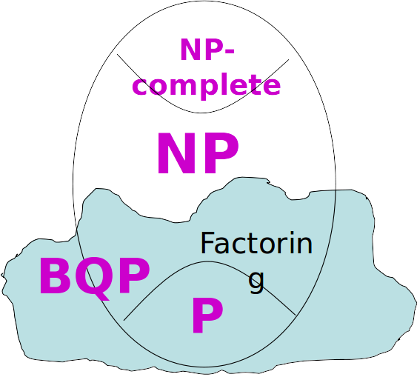
What can a Quantum Computer ‘supposedly Do Better?
BQP =Bounded error Quantum Polynomial time

Slide 5
0%
BUt the Talk isn’t about that!!!
Is the probability that I am going to sing glories about Quantum Computing.

Slide 6
This Talk is about the Beauty of a System of Logic called which has ‘something’ to do with Putting Cats in boxes.

Slide 7
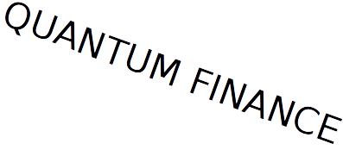
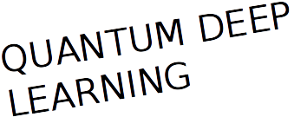
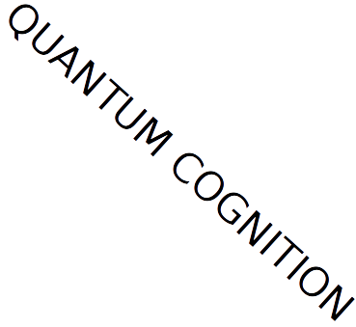
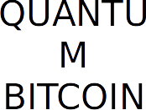
How should you think about quantum computing- nOT LIKE A BUZZWORD

Slide 8
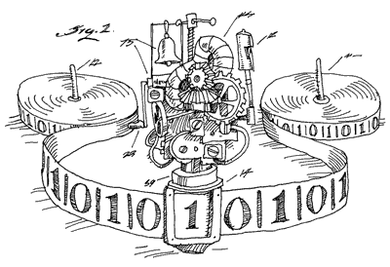
Think of it as A Computing Model
...Having rules for calculating things.

Slide 9
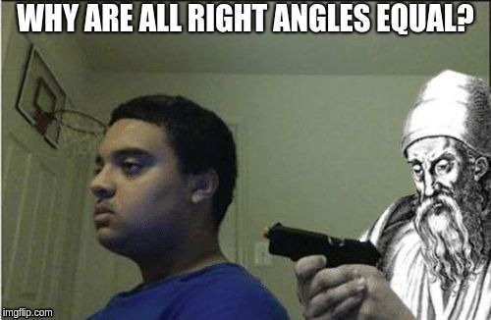
As A system of Logic
Quantum Computation is very much like Euclid’s Geometry
Trust its ‘laws’ just like you believed “All right angles are equal to one another” when you were in high school.

Slide 10
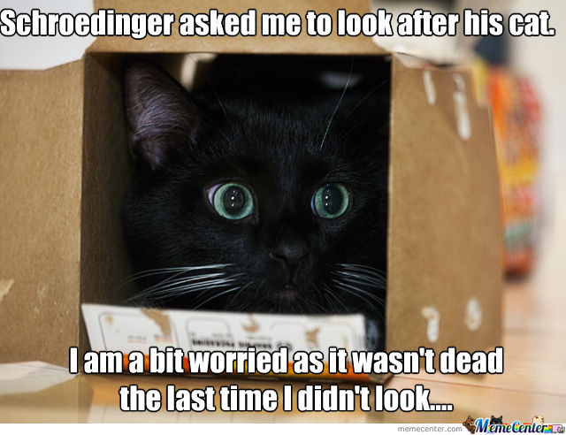
Don’t think about cats

Slide 11
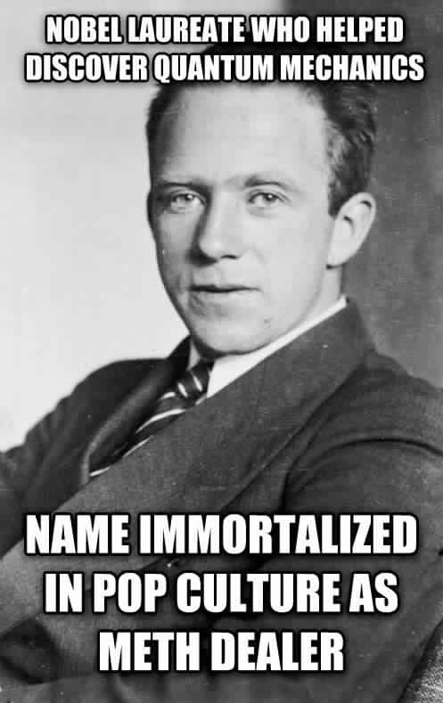
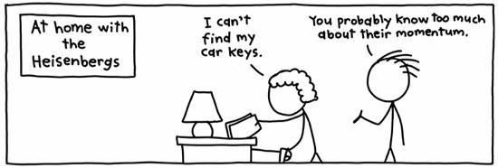
Don’t think about this guy...

Slide 12
“Seriously...Quantum Systems are easy, they are just probabilities with negative signs”

Slide 13
BASICS..

Slide 14
Hilbert Space
Fancy term for space of vectors.
have complex number components.
These vectors can be added, subtracted, multiplied by a scalar or a vector
Represented by a column matrix and have a special name in Quantum Mechanics...KETS
Every ket can be expressed as a linear combination of orthonormal unit vectors called basis vectors.
Symbol of ket

Slide 15
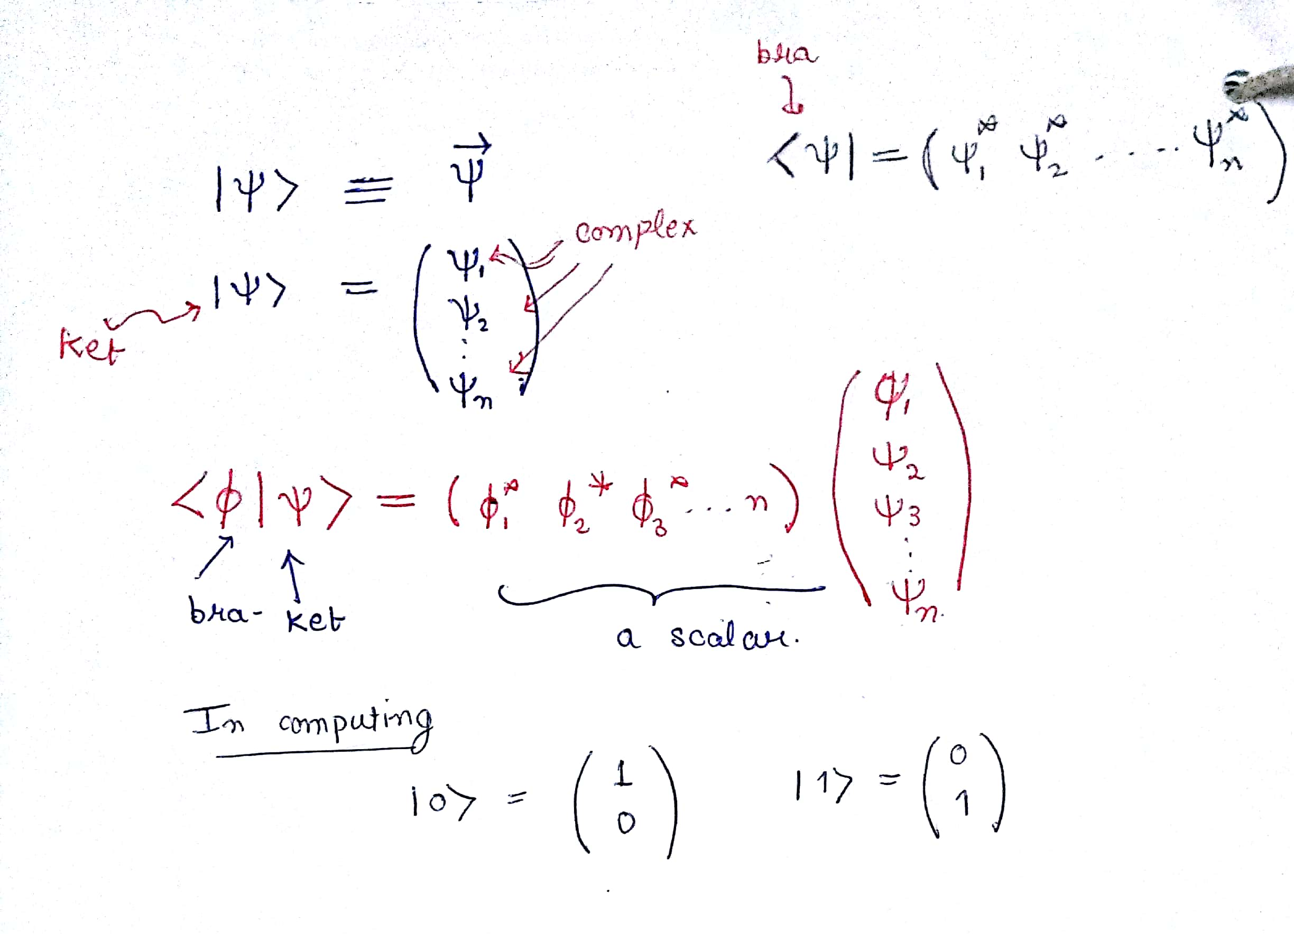
Hilbert Space continued

Slide 16
State
Description of the system
Is described completely by a ket having unit length. (Important).
Unlike classical mechanics, in Quantum mechanics states can be added and multiplied with other states (kets).
If a system can exist in two states, it can also exist in any linear combination of those two states. (Quantum Interference).

Slide 17
So what’s all the Fuss about ‘Qubits’?

Slide 18
Classical Bit
It can only be in two ‘classical’ states, a 0 or a 1. NOTHING ELSE.

Slide 19
Qubit
A Qubit can be in two states |0> and |1> (analogous to classical bits). These states are called ‘computational’ basis states.
BUT A Qubit CAN ALSO BE IN A LINEAR COMBINATION OF |0> AND |1>.
This means a*|0> + b*|1> is also a valid qubit state. (no classical analog).

Slide 20
What if there are more than 1 Qubit?
The computational basis for such a 2 Qubit system is |00>, |01>, |10>, |11>.
A general 2 Qubit system is a*|00> + b*|01> + c*|10> + d*|11>.
Is it possible to represent two single qubit system as a single multi-Qubit system?
YES

Slide 21
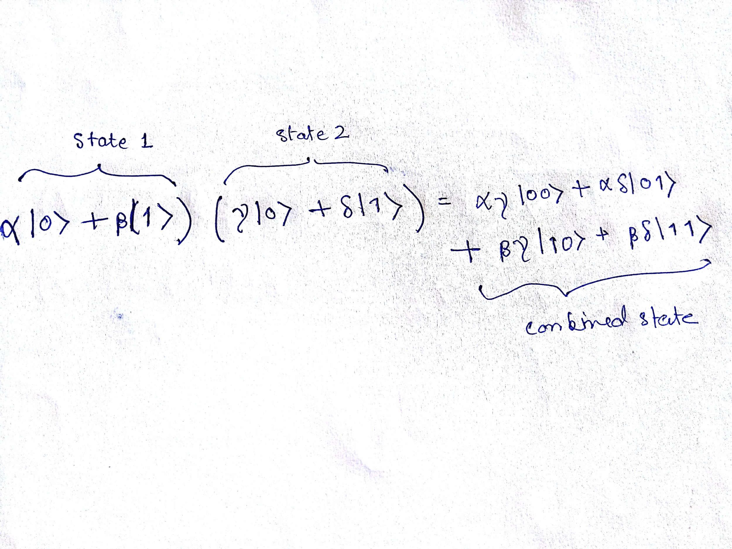
Combining single Qubit Systems
This operation is called the Tensor Product.

Slide 22
Can all 2 Qubit Systems be written as a combination of Single Qubit System?

Slide 23
No...And such systems are said to be ‘Entangled’
This phenomena really is the heart of Quantum Computing.
Classically one can treat a 2-bit system as a combination of single bit systems.
But entangled states in Quantum Mechanics cannot be interpreted in the same way.
Ex. Bell State

Slide 24
Operators
These are linear operators represented by matrices.
In the language of Quantum Computation, these are called GATES (analogous to gates in digital circuits).
1 ket into another

Slide 25
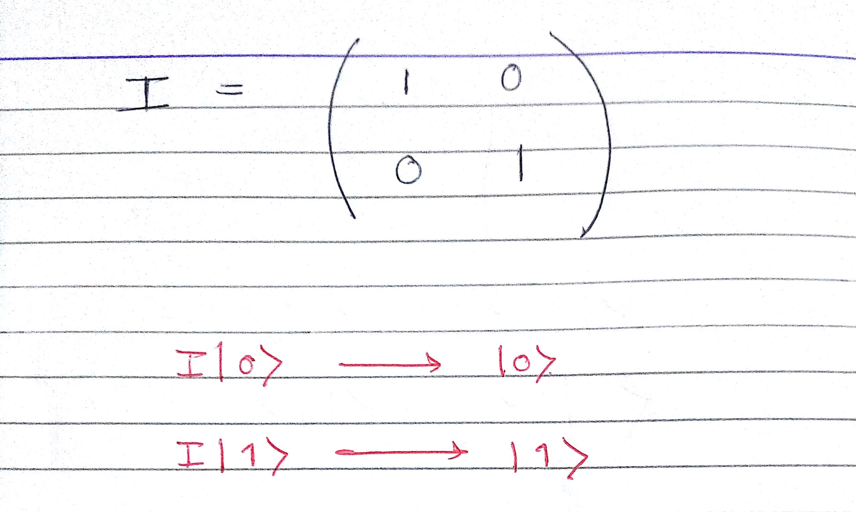
Identity gate

Slide 26
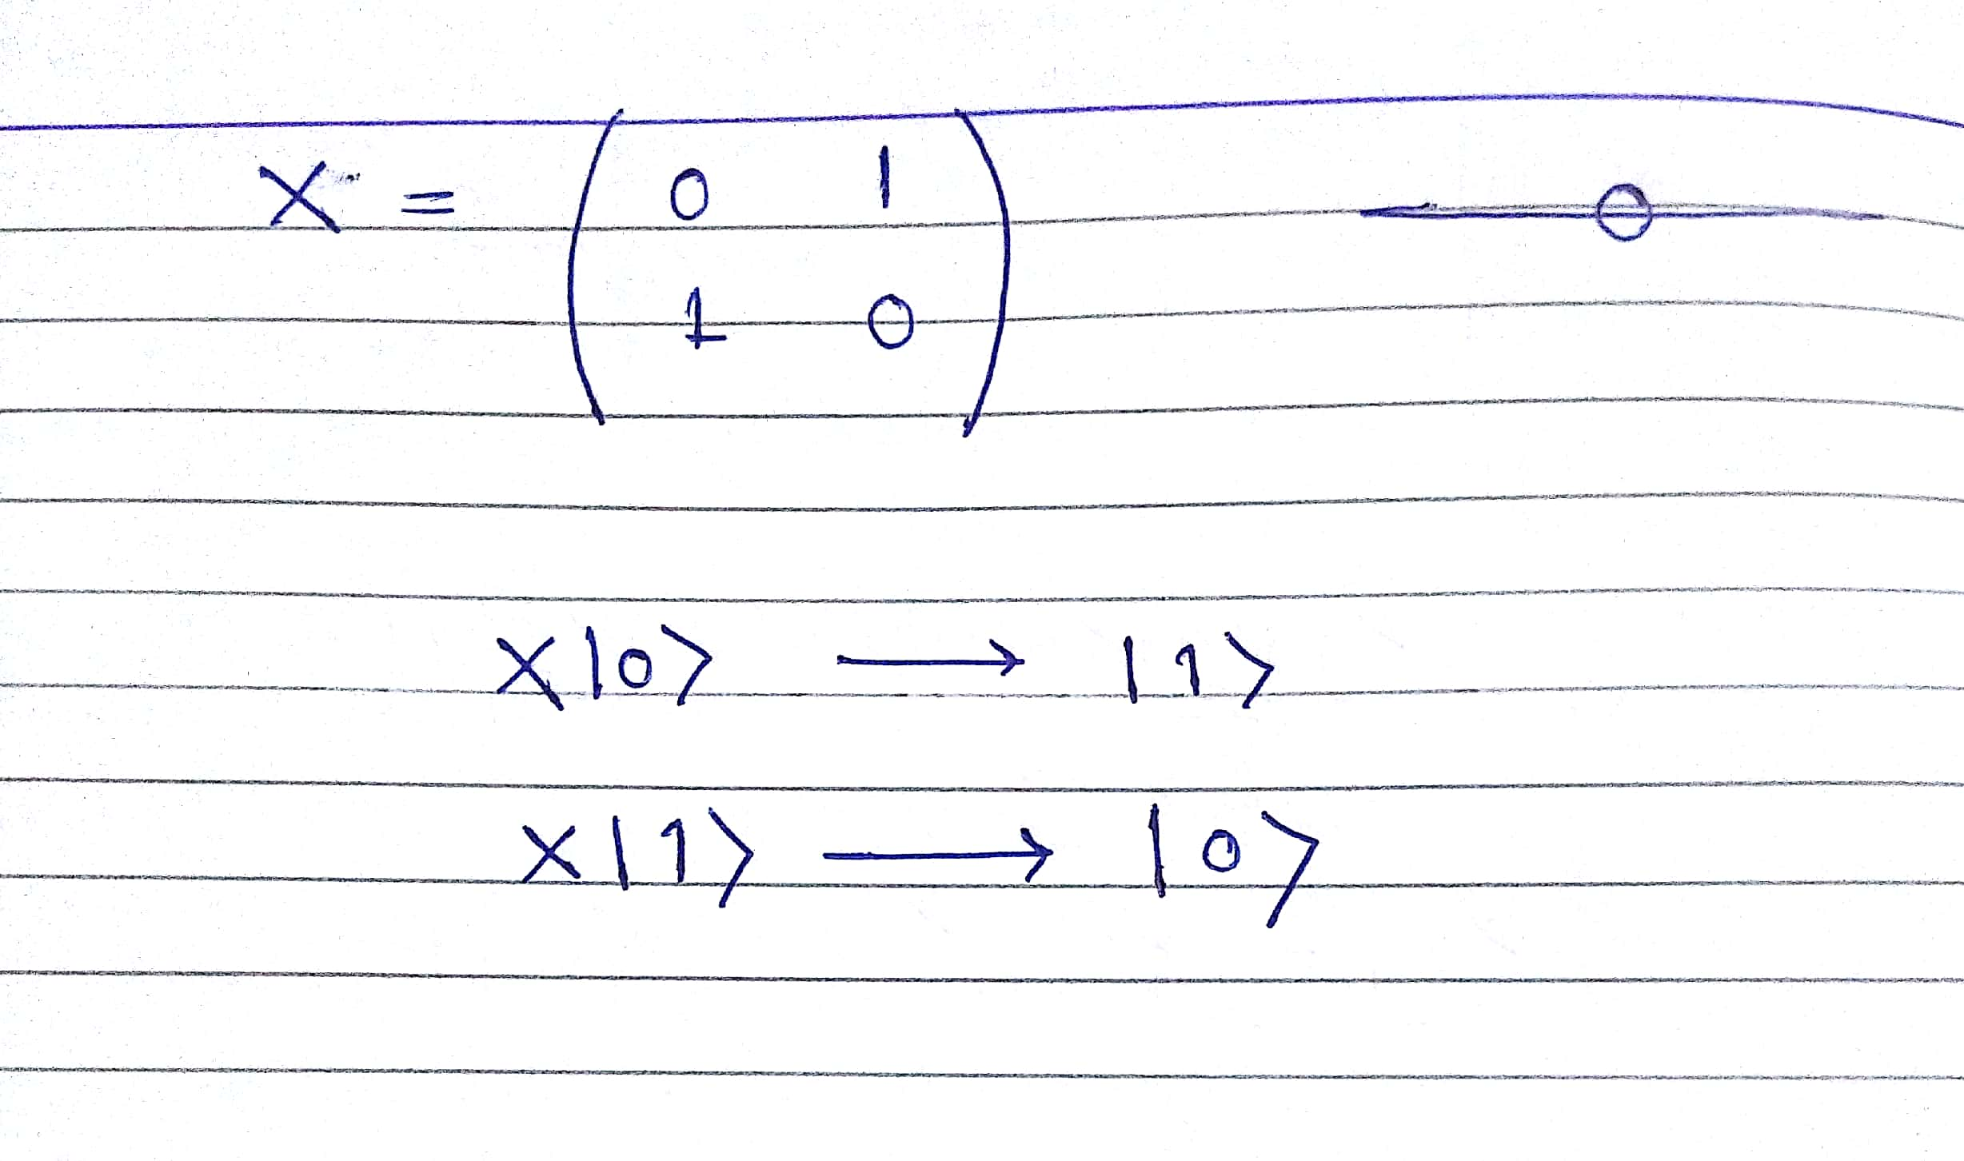
Quantum NOT GAte

Slide 27
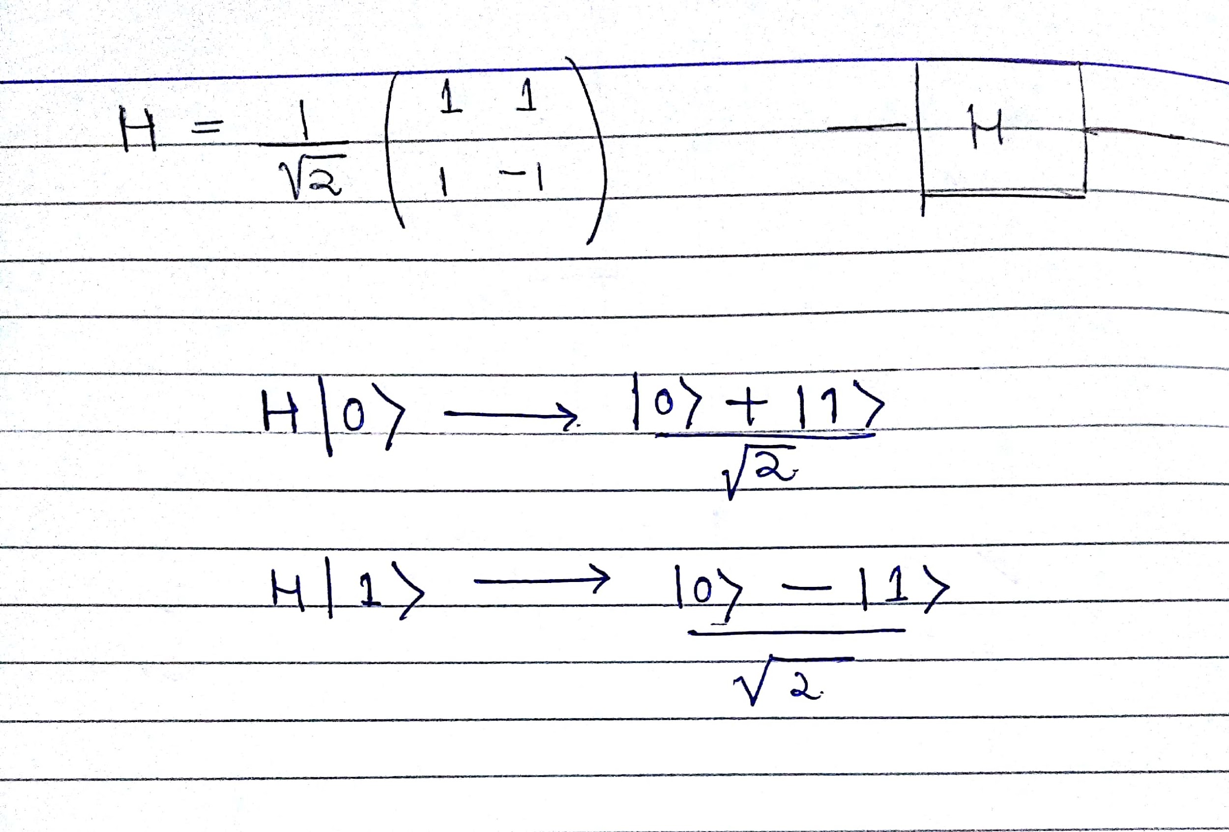
Hadamard Gate

Slide 28
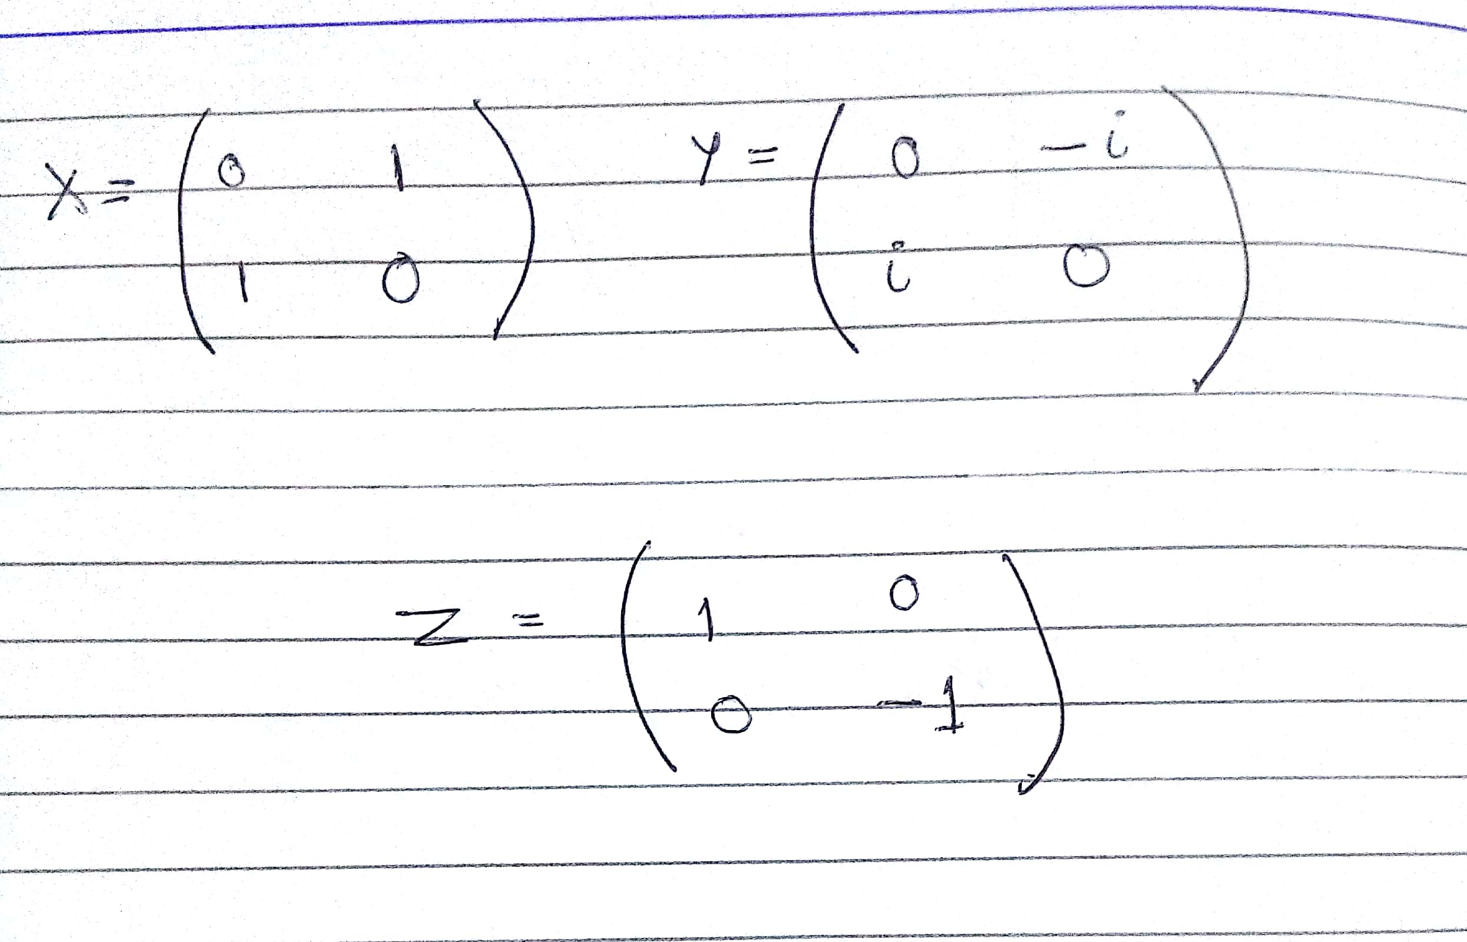
Pauli Gates

Slide 29
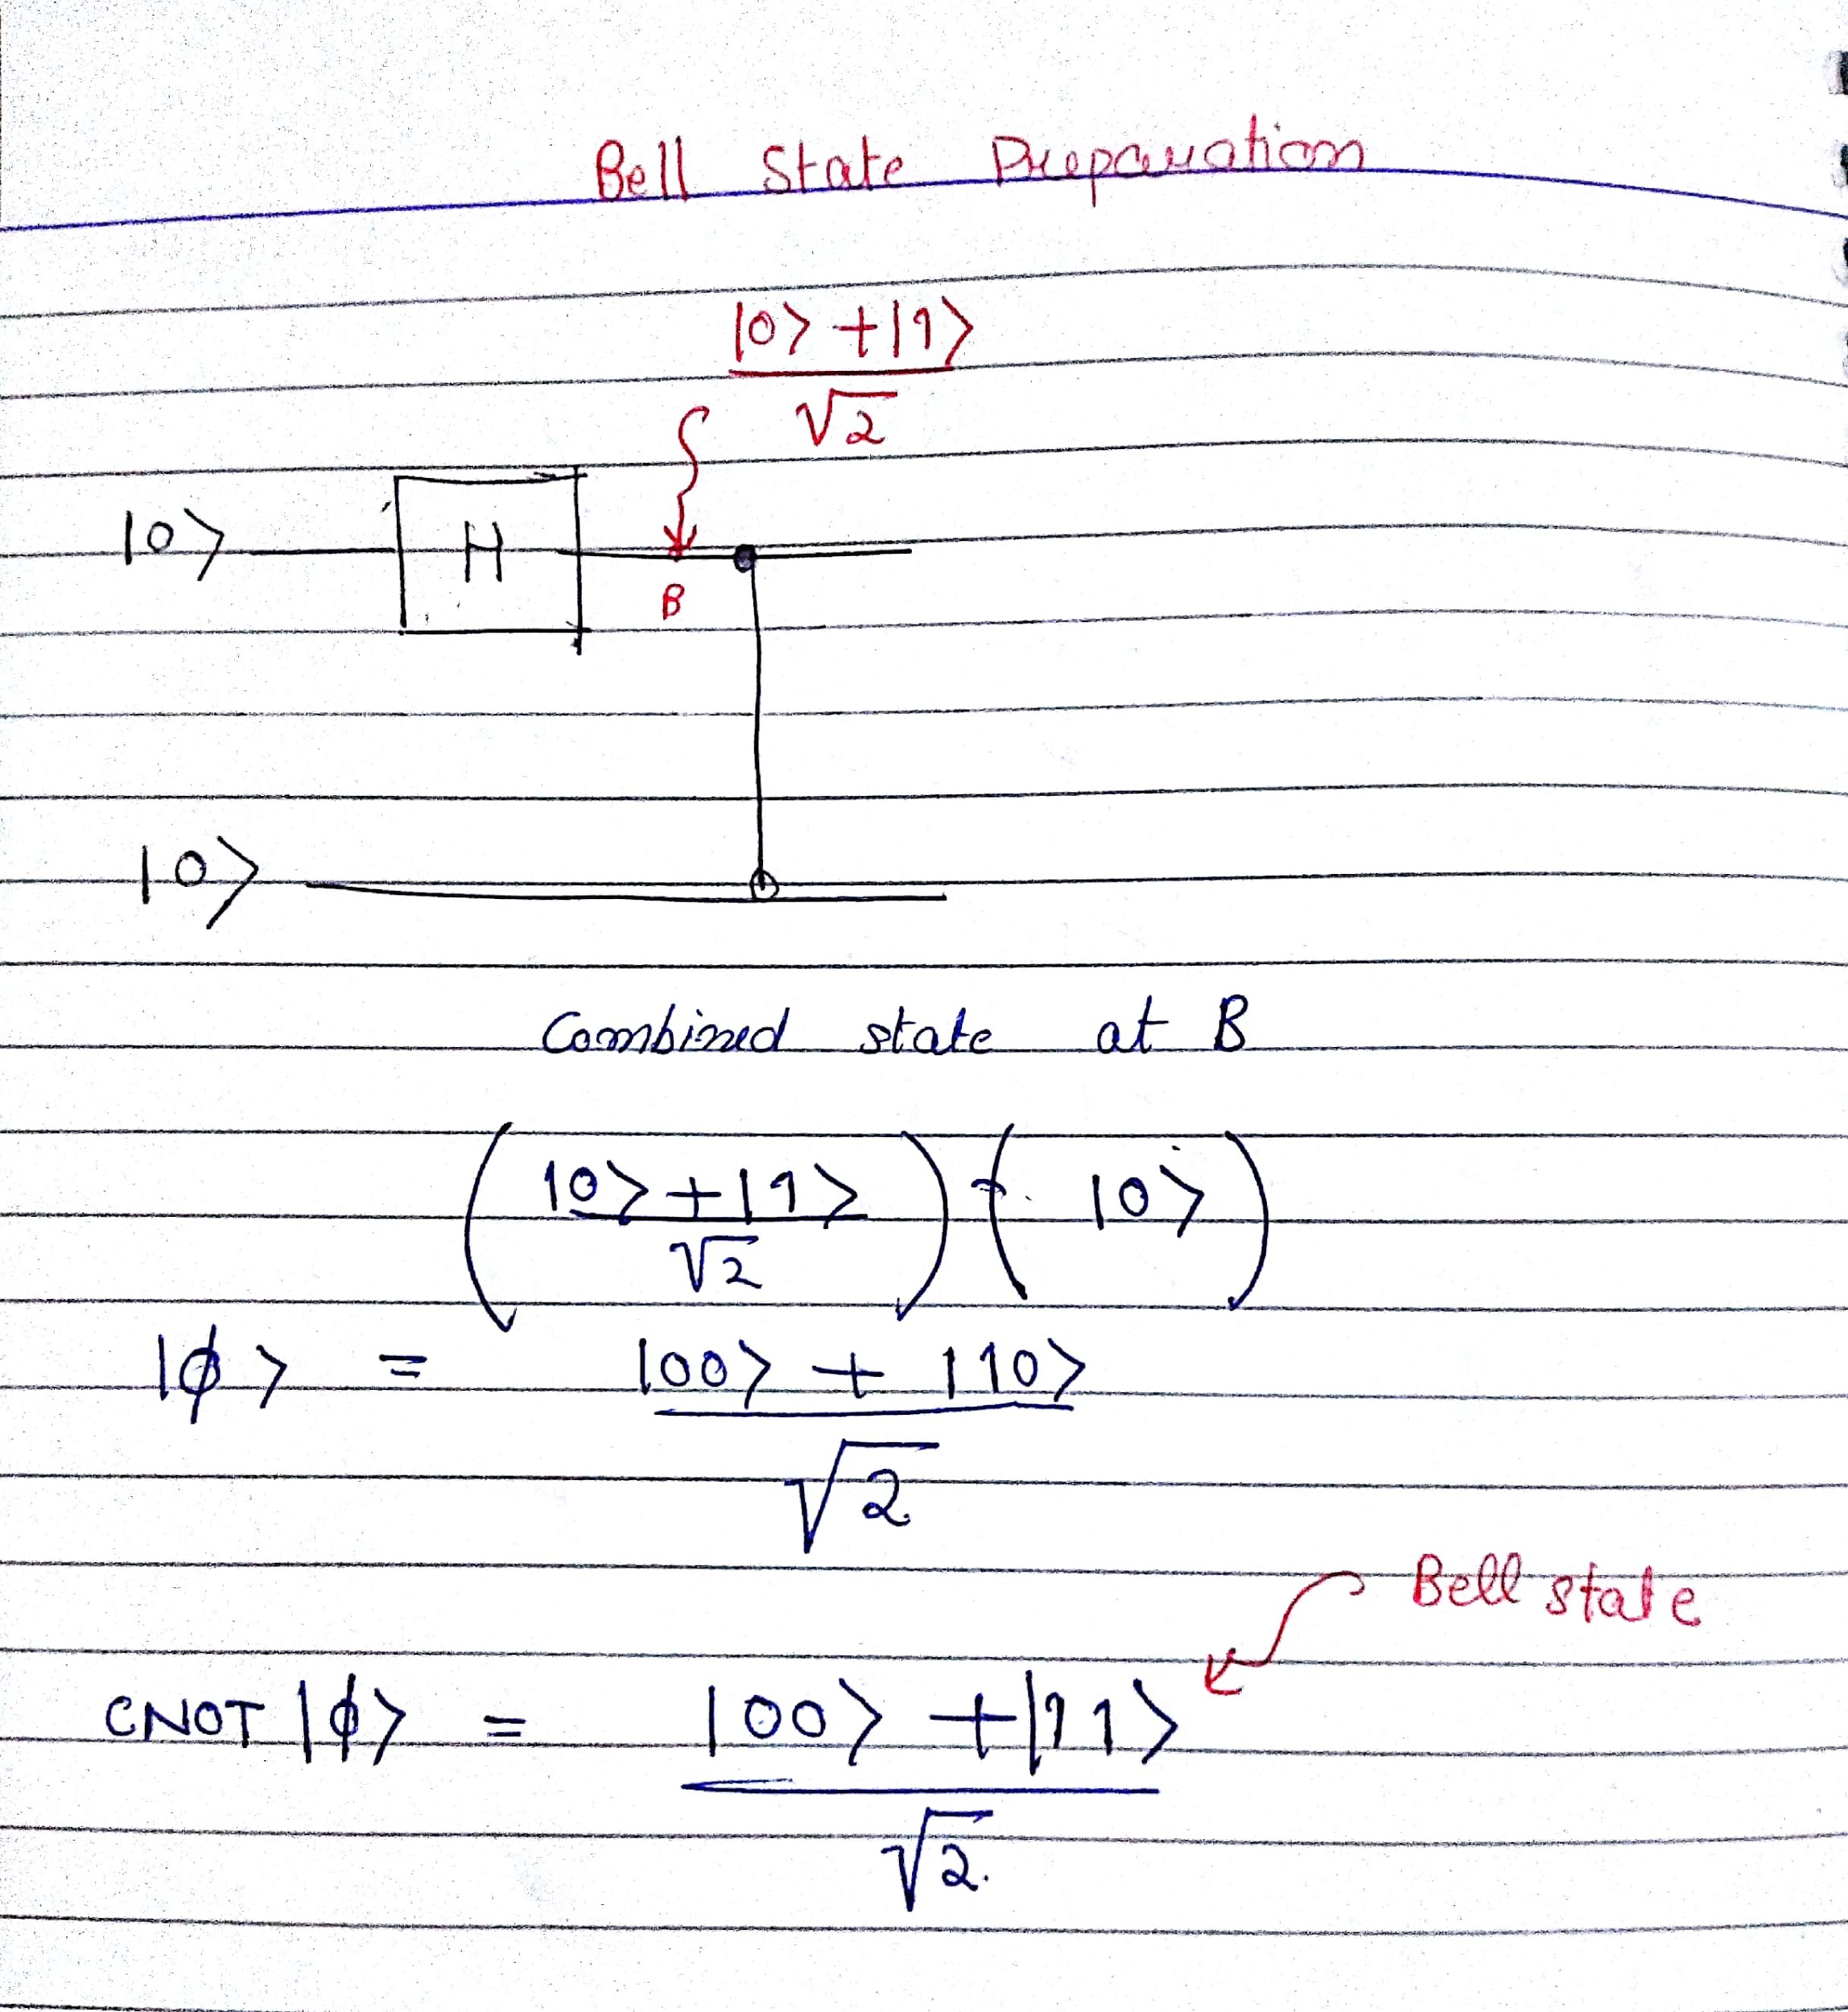
Making an Entangled State

Slide 30
OOff...Anything Else?

Slide 31
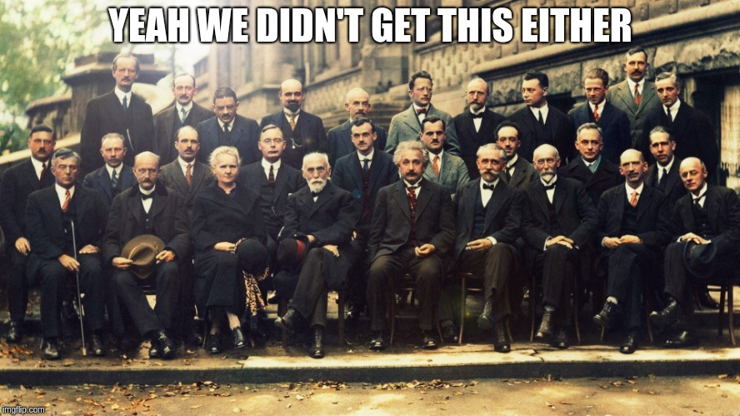
Perhaps the Most Unsettling Principle of Quantum Mechanics

Slide 32
Measurement of quantum Systems

Slide 33
Measurement...A destructive phenomena
Though quantum states can be a linear combination of basis vectors, the act of ‘measurement’ collapses, to one of the basis vectors. After measurement the state remains equal to that basis vector.

Slide 34
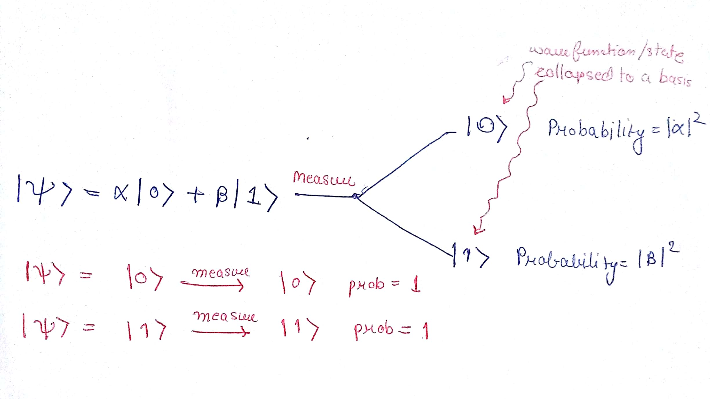

Slide 35
Okay... So The Bare Minimum basics are Over, How much is all of this equivalent to classical Computation?

Slide 36
Equivalent to where you were when you were using and, or gates!!!

Slide 37
OMG!!! So Much for so Little?

Slide 38
Not Quite...There is a simple program that can demonstrate the power of Quantum Logic

Slide 39
SuperDense Coding
Sending 2 classical bits of information using a single Qubit.

Slide 40
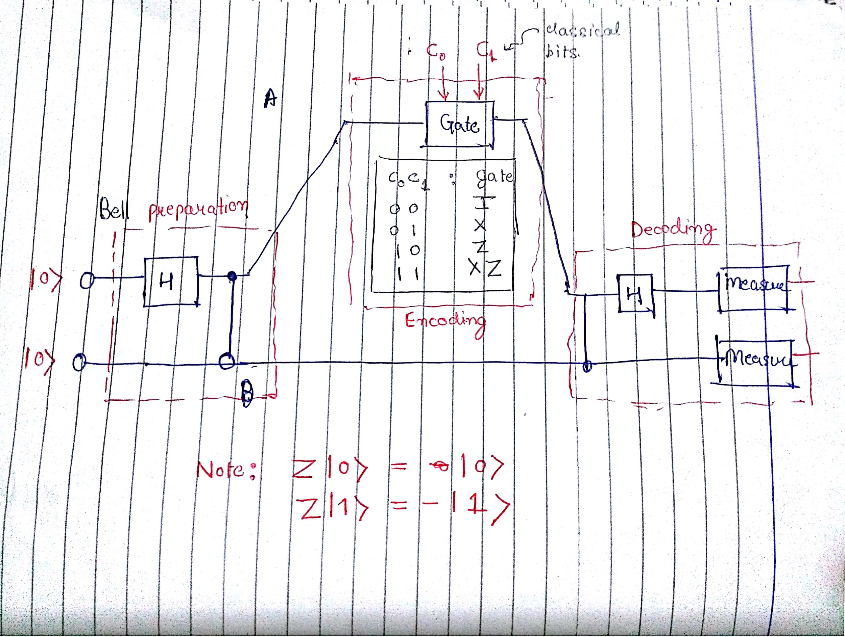
SuperDense Coding Protocol

Slide 41
Procedure Outline
First entangle the states of the 2 Qubits
Give one to the sender other to receiver.
The sender would apply a gate to its Qubit depending on the classical bits it has.
The sender would send its bit to the receiver.
The receiver would then decode the classical bits from its Qubit and the Qubit it receives.

Slide 42
Calculations-1

Slide 43
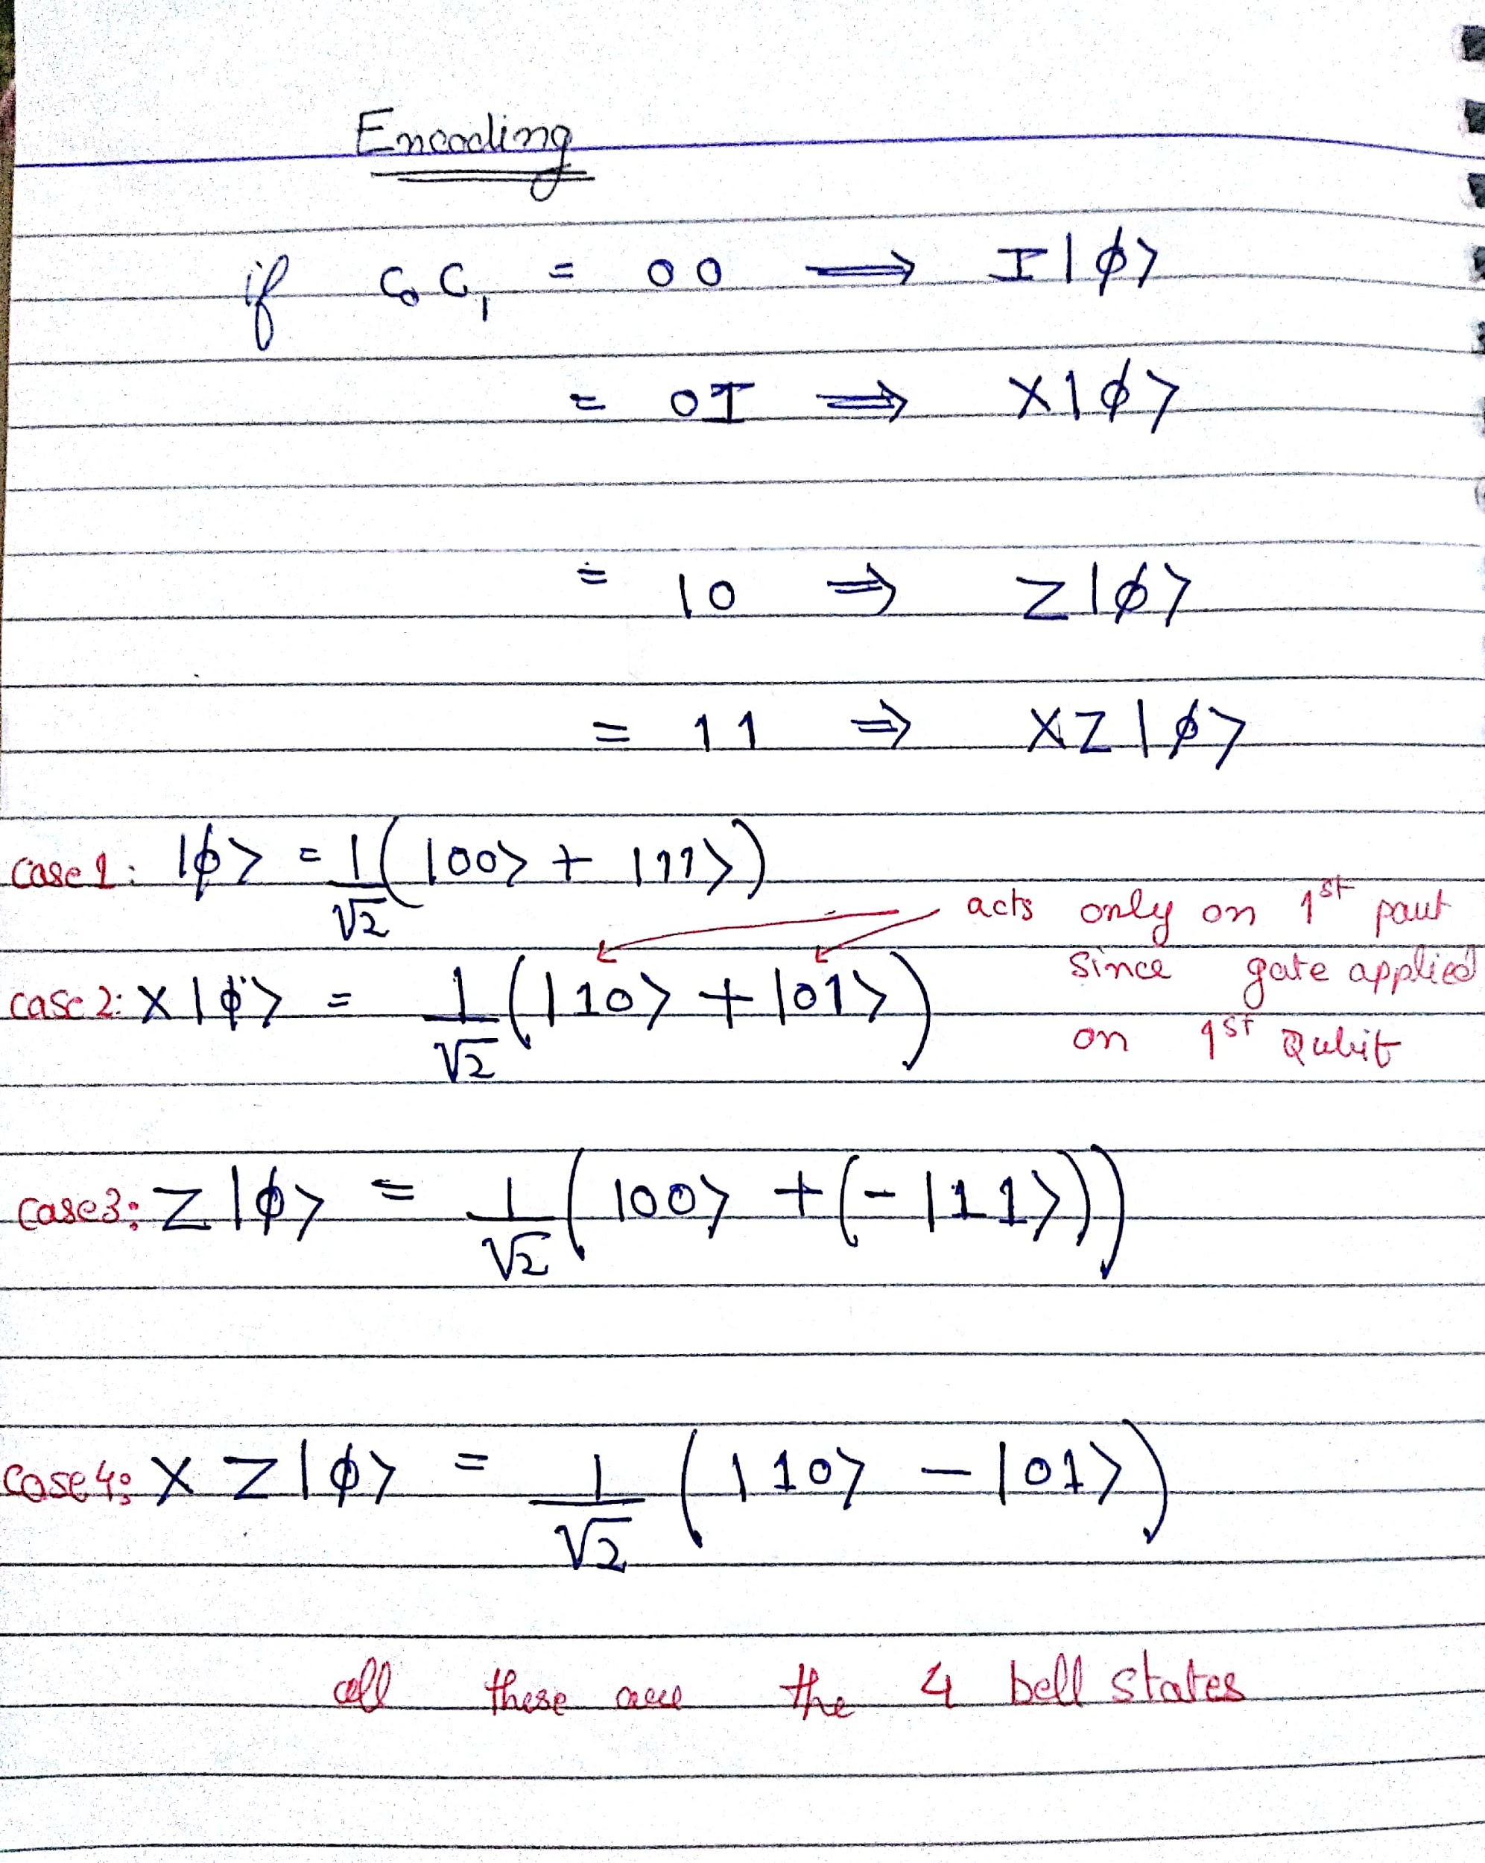
Calculations-2

Slide 44
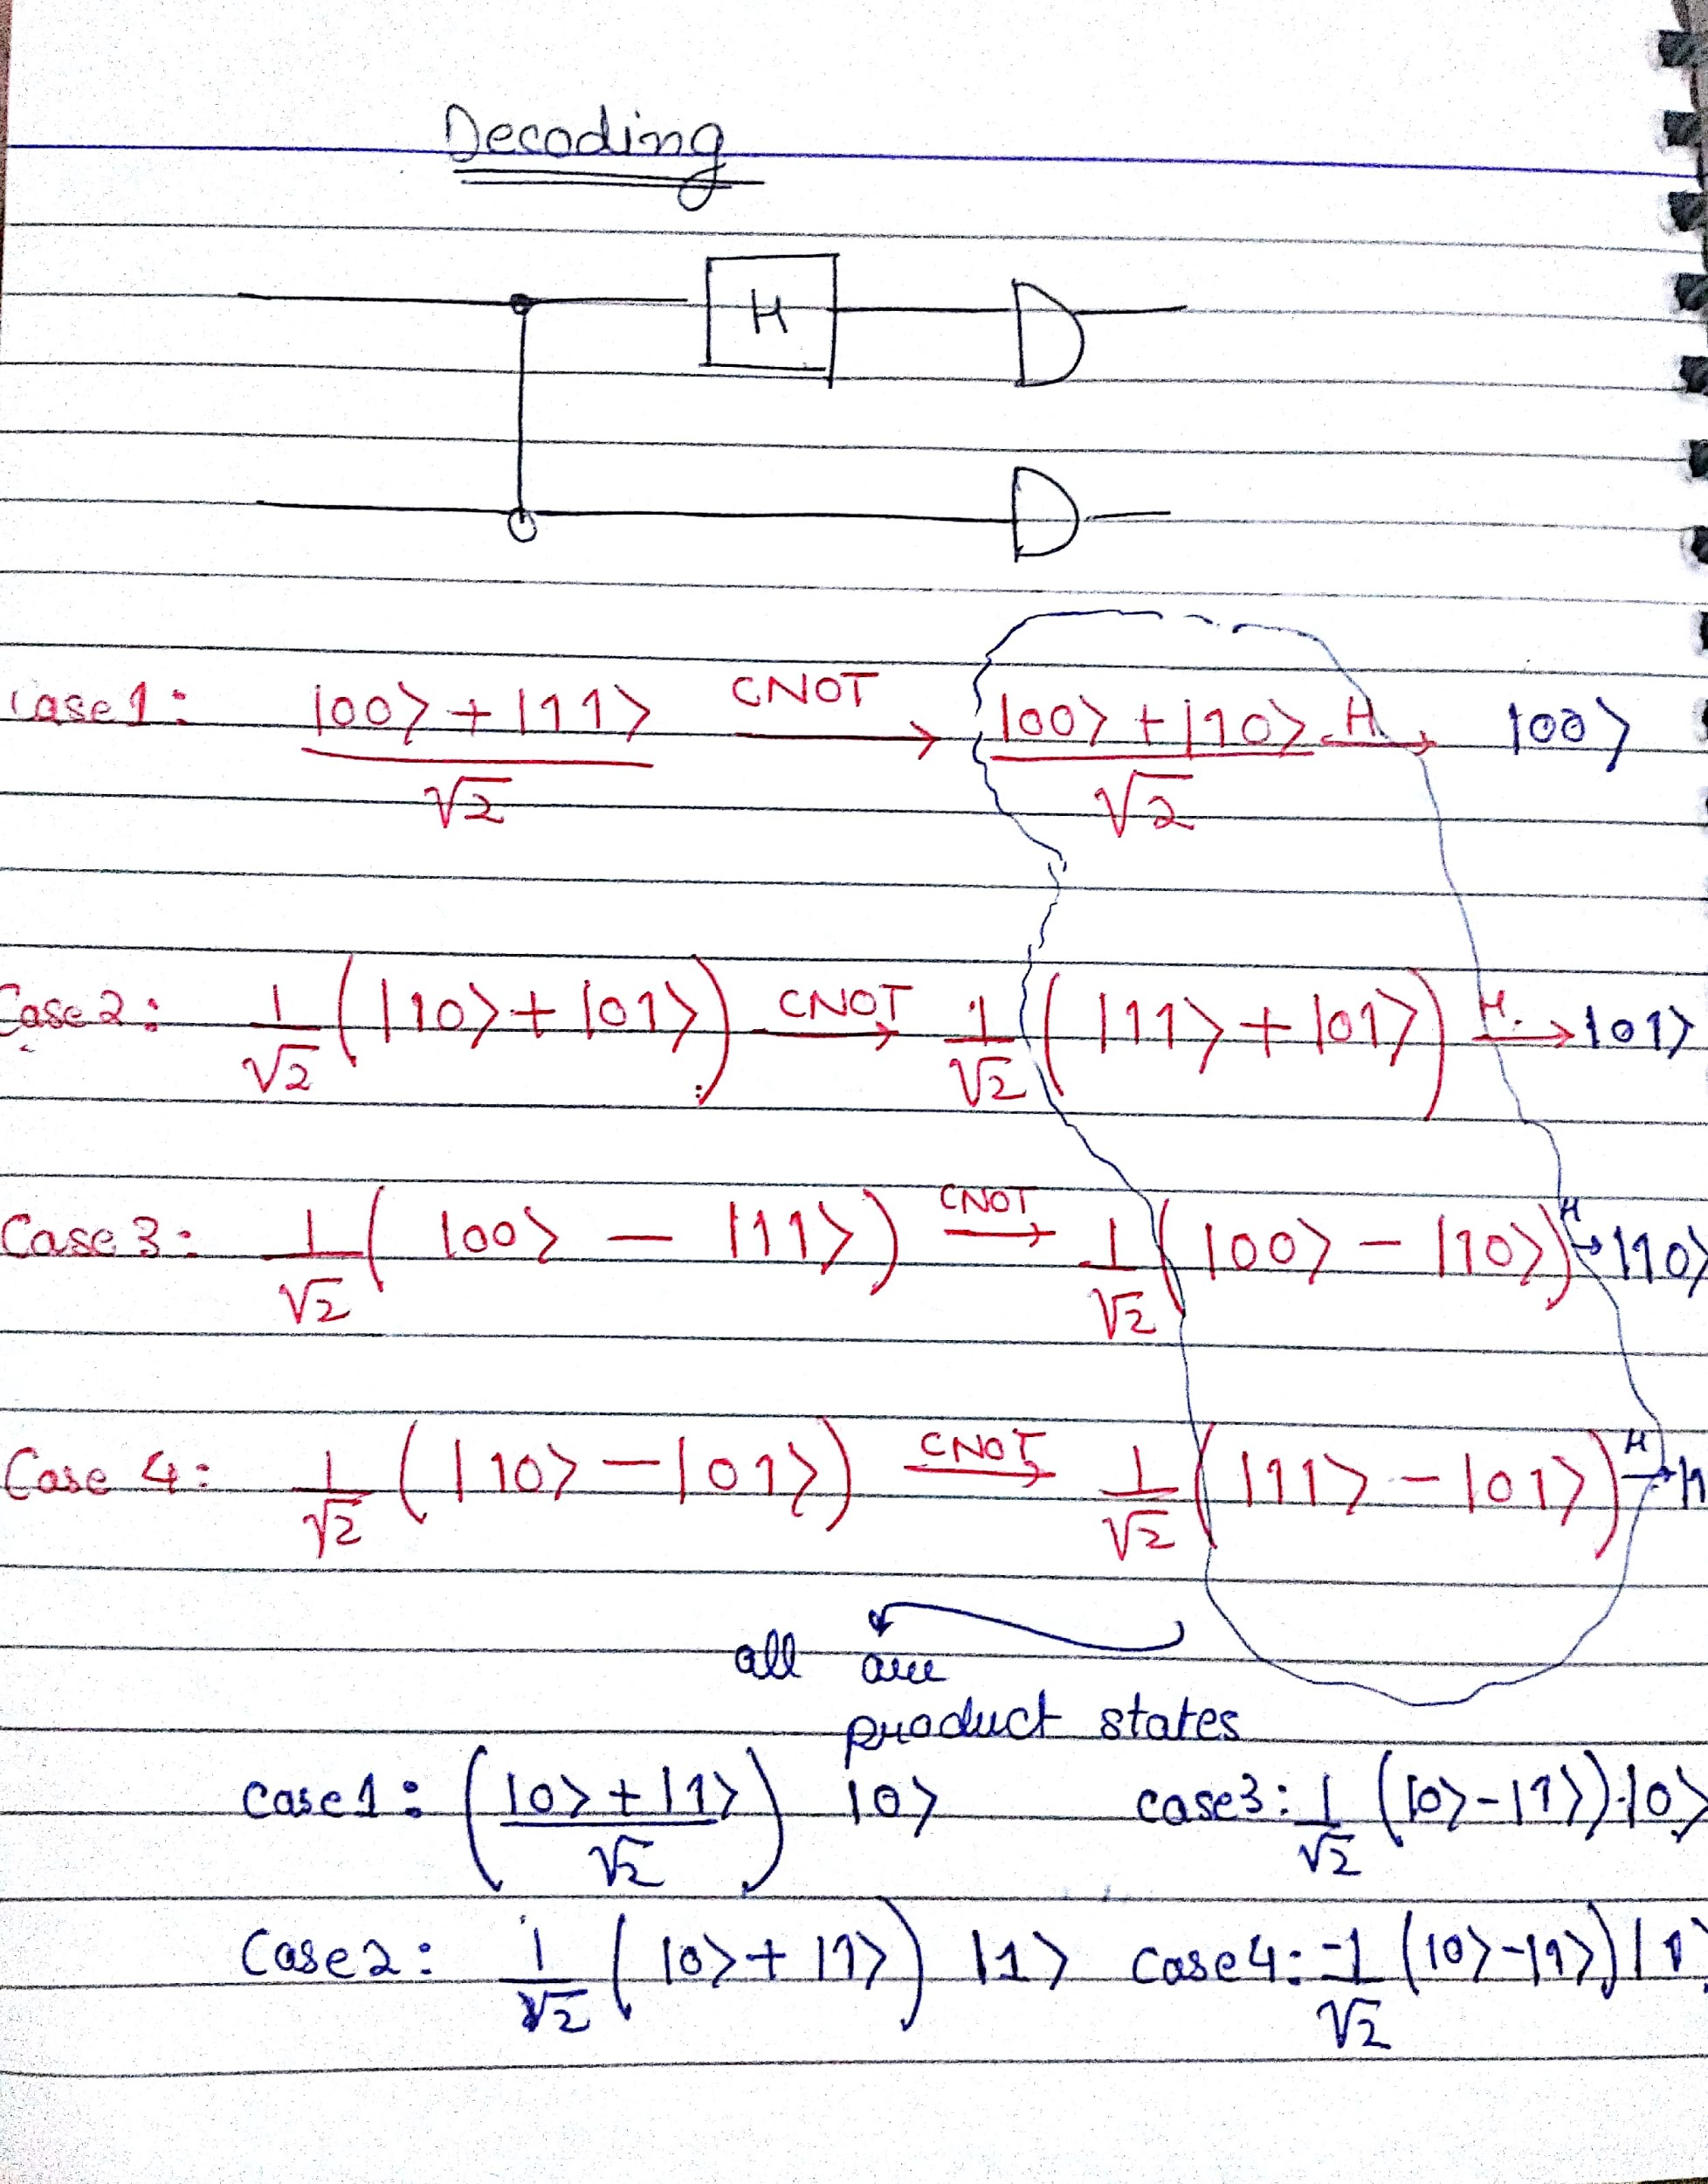
Calculations-3

Slide 45
Where is the Code?

Slide 46
What Next? How to go about studying more?

Slide 47
Brush up Your Linear Algebra

Slide 48
Books
Quantum Computation and Quantum Information, Michael Nielson
Quantum Computing since Democritus.
Michael Nielson’s Quantum Computing videos.

